Slide 1
programação Orientada a objetos Avançada 2019/1
Prof. Dr. Valter Vieira de Camargo
Departamento de Computação - UFSCar

Slide 2
Abstração

Slide 3
Abstração
It is a good definition:
Abstraction is the process of filtering out – ignoring - the characteristics of patterns that we don't need in order to concentrate on those that we need. It is also the filtering out of specific details. From this we create a representation (idea) of what we are trying to solve.
Computer science, being primarily concerned with developing interaction patterns, has information hiding as its abstraction objective. (Colburn T., Shute G. 2007)

Slide 4
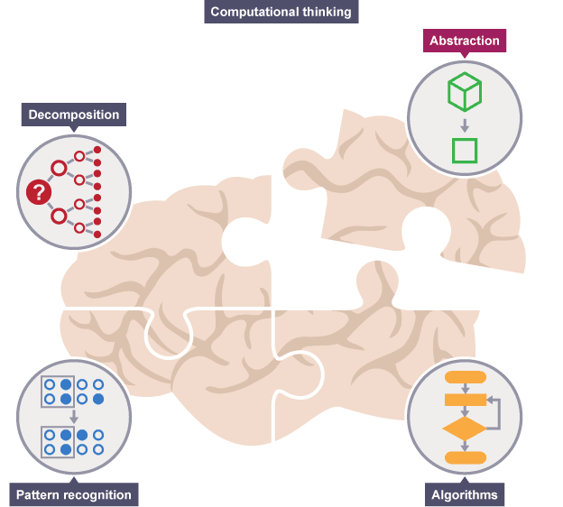
The Four CornerStones of Computer Science

Slide 5
Cat Examples
Consider the problem of Drawing a Series of Cats
We note that all cats have general characteristics: fur, tail and eyes.
To draw a cat, we do need to know that they have tail, fur and eyes (relevant characteristics)....
We do not need to know the sound they make or if they like fishes (irrelevante characteristics).
Model
Is a general idea of the problem we are trying to solve
The model representes all cats

Slide 6
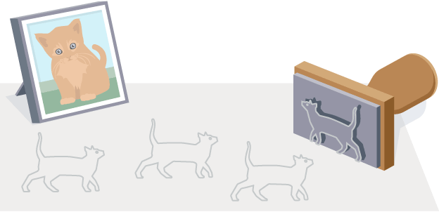
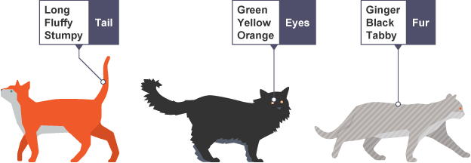

Slide 7
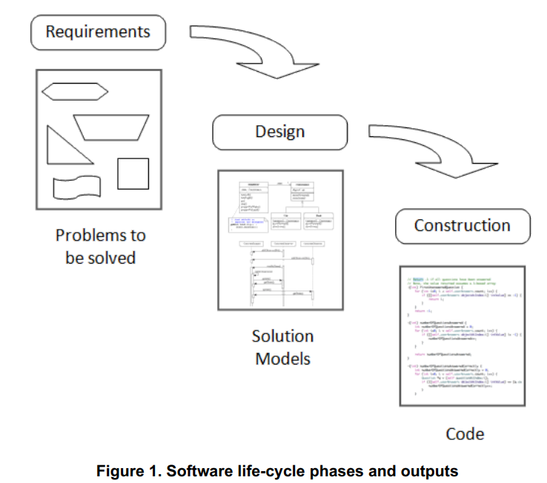
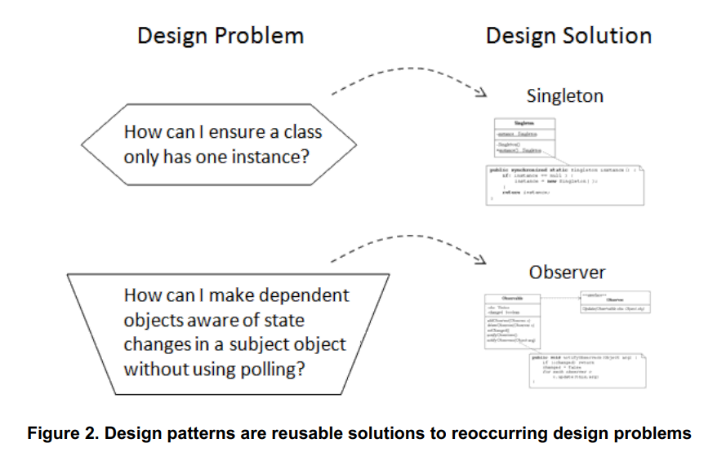

Slide 8
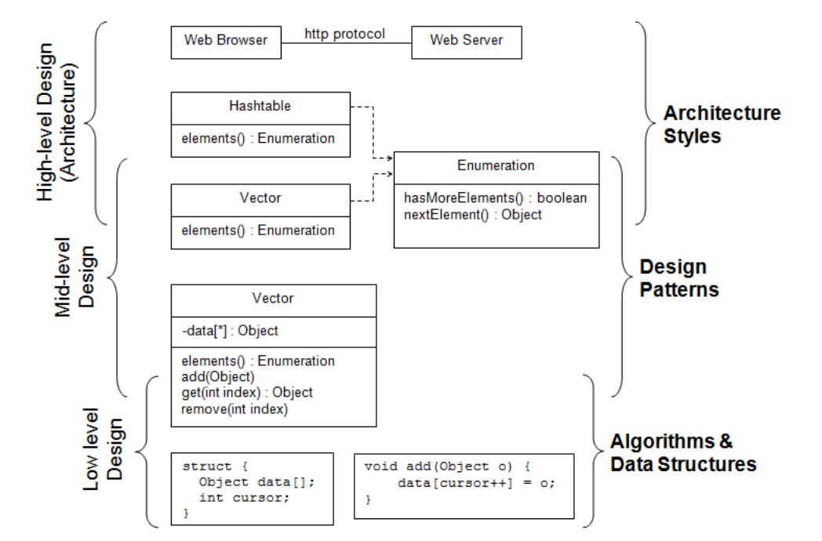

Slide 9
Interfaces, design for change.... Etc..

Slide 10
Introduction
How to decompose a system into objects ?
Nouns ?
Colaborations among objets ?
Responsibilities ?
Real world ?
Modelling a system as the real world may represent the present, but not the future ☹
The abstractions used during the project are the key for flexible designs

Slide 11
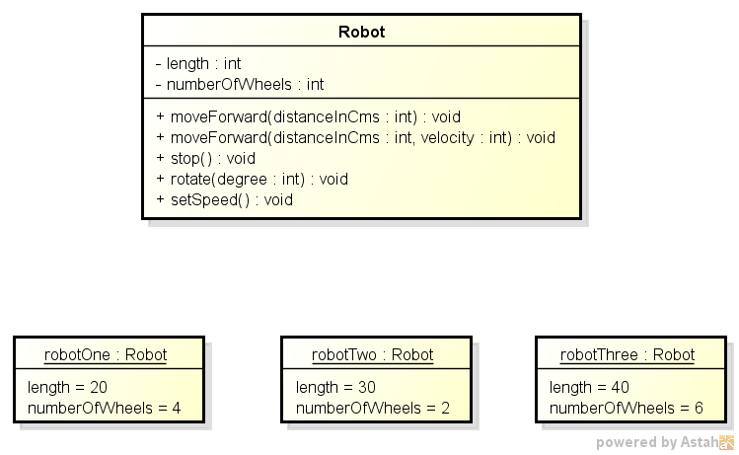
Interfaces...
Interfaces
Interfaces are the set of signatures an object exposes
The interface of an object states all the requisitions can be sent to it
A Type is a name used to denote a specific interface
Objects can have several types (hierarchy)
Interfaces do not say anything about the object’s implementation (i.e., the internals of methods)
Type
Robot´s Interface
Instances

Slide 12
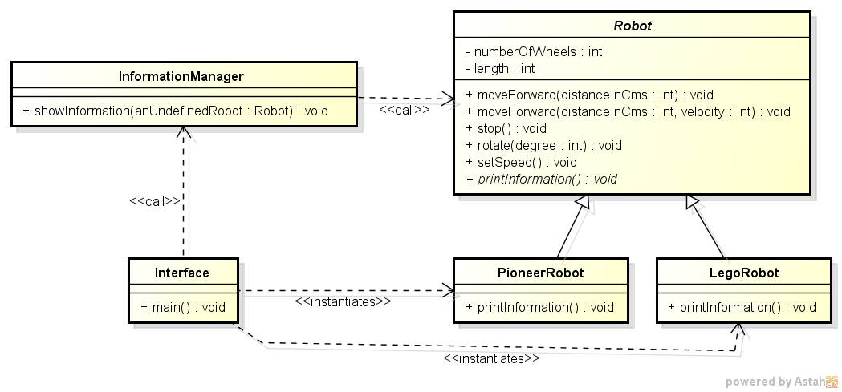
Dynamic Binding
Application Example Requirements
it is required an application which manages, initially, two types of robots;
a lego mobile robot and a pioneer robot
The application must have a module responsible for printing robot´s information;
What is “Dynamic binding” ?
The link between a request to an object to one of its operations in runtime (thanks to polymorphism)
public static void main(String args[]){
Robot robotOne;
if (condition){
robotOne = new LegoRobot();
}
else{
robotOne = new PioneerRobot();
}
InformationManager.showInformation(robotOne);
}
public class InformationManager {
public static void showInformation(Robot anUndefinedRobot){
anUndefinedRobot.printInformation();
}
}
public class PioneerRobot extends Robot {
@Override
public void printInformation() {
System.out.println("This is a pionner robot");
}
Aqui está a mágica

Slide 13
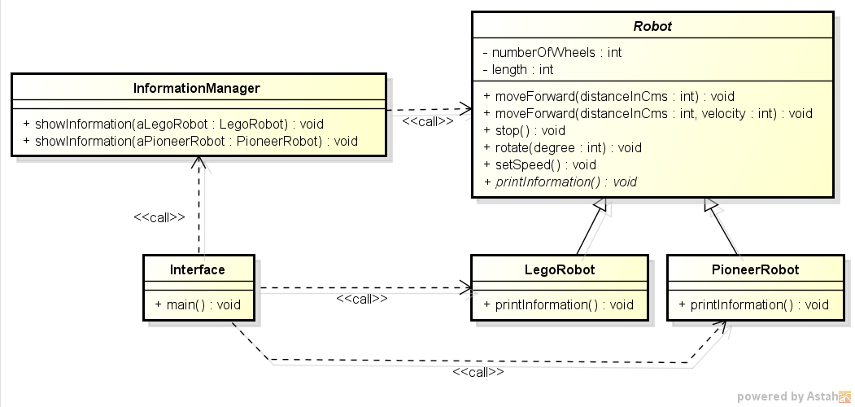
Static Binding...
public static void main(String args[]){
PioneerRobot pioneerRobot = new PioneerRobot();
LegoRobot aLegoRobot = new LegoRobot();
String type = "null";
if (type == "pioneer"){
ShowInformation.showInformation(pioneerRobot);
}
else{
ShowInformation.showInformation(aLegoRobot);
}
}
public class PioneerRobot extends Robot {
public void printInformation() {
System.out.println("This is a pionner robot");
}
}
public class InformationManager {
public static void showInformation(LegoRobot aLegoRobot){
aLegoRobot.printInformation();
}
public static void showInformation(PioneerRobot aPioneerRobot){
aPioneerRobot.printInformation();
}
}
public class LegoRobot extends Robot {
public void printInformation() {
System.out.println("This is a lego robot !");
}
}

Slide 14
Suppose we must change...
Now, there are new types of robots
Static version:
At every new concrete robot class, there will be a modification in the Main (expected);
InformationManager needs new methods for every new robot
Dynamic version:
At every new concrete robot class, there will be a new instance in the Main (expected)
No modifications in the InformationManager
Now, the printInformation() method must have a new parameter. (interface modification)
Static:
Modifications at every printInformation() call
Dynamic:
Modifications at every printInformation() call
The most clear benefit is when creating new types or changing parameters

Slide 15
Program for Interfaces...
You need to program for interfaces, not for particular implementations
Using inheritance you can define family of objects sharing identical interfaces
All subclasses are able to reply to the requests forwarded to the interface of the abstract class
Benefit of manipulating objects only considering their interfaces
The clients keep unaware of the type of the objects they use

Slide 16
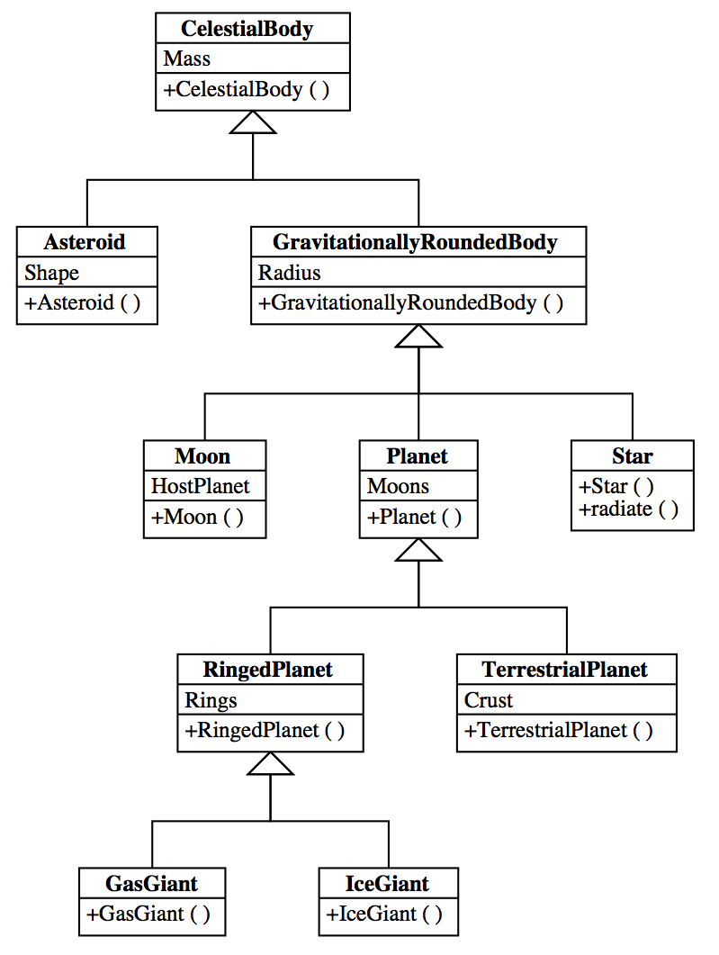
Inheritance x composition
Classe Inheritance x Composition of Objects
Inheritance
Compilation time
It is not possible to change the inherited implementation in runtime
Encapsulation is violated – both classes become too coupled
It is preferable to inherit just from abstract classes
Creating an object of GasGiant, implies in the coupling of a lot of objects

Slide 17
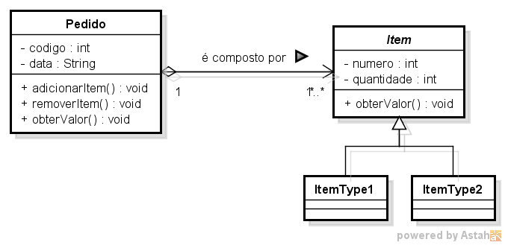
Inheritance x Composition
Classe Inheritance x Composition of Objects
Composition
Composition of objects is defined dynamically, in runtime
There is no encapsulation violations
Any object can be exchanged by another in runtime, since they share the same type
public class Pedido {
private <Item> itens;
}

Slide 18
Delegation
Delegation is a means to make the composition of objects as powerfull as inheritance
Two objects are involved to handle a request; the receptor and the delegate
Example: Windows and Rectangle

Slide 19
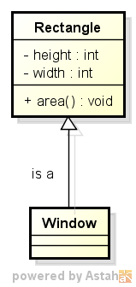
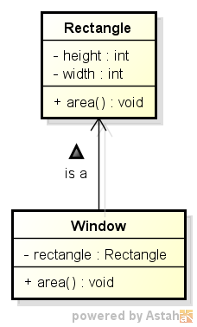
Example Delegation
The window could turn itself into a circle
or another geometric
Form. If they shared
the same supertype....
public class Window {
private Rectangle rectangle;
public Window(int height, int widht){
this.rectangle = new Rectangle(height, widht);
}
public int area(){
return this.rectangle.area();
}
}
Inheritance
Delegation
public class ClientCode {
public static void main(String[] args) {
Window myRectangleWindow = new Window(10,10);
System.out.println("The area of the window is " + myRectangleWindow.area());
} }

Slide 20
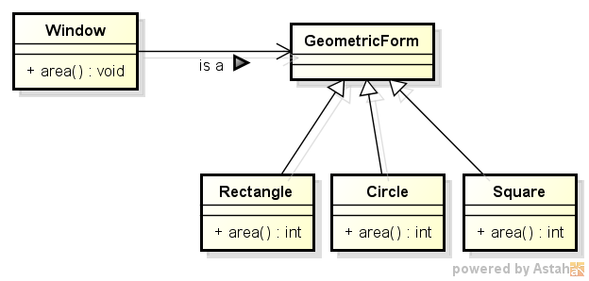
Example Delegation
The window could turn itself into a circle
or another geometric
Form. If they shared
the same supertype....
public class Window {
private GeometricForm form;
...
public int area(){
return this.form.area();
}
}

Slide 21
Design for Change
Non-antecipated changes are more expensive to be done
Known problems
Creating objects by means of the explicit specification of their classes;
Dependency on how objects are implemented
Clients may be required to change too
Platform dependency
APIs
Dependency from specific operations
Algorithms dependency
Strong coupling among classes
Extending functionalities using subclassing
Composition and delegation can be a good alternative

